Slide 1
Doing ACT with Children & Families
Dr Sacha Rombouts, PhD

Slide 2
Overview
Working with children, parents & teachers
The ACT Processes
Action Heroes as a metaphor for use with children
Exercises – for you & for you-as-clients
Remember that the clients will give you what you need to do ACT!
Notes:
When I work with a child I try to work with members of that child’s system – primarily family system (parents, siblings) and school system (teachers, special needs support, deputy principals). In my practice I offer to go out to the school for free and (a) do observations of the child in classroom and/or playground and/or (b) meet with relevant staff. You could charge for this but I tend to do it for free as part of the service that I offer.

Slide 3
About Happy Minds
Happy Minds, Happy Schools, Happy Communities
Engaging children + helping parents
Any age + variety + special (ASD)
Action Heroes (www.actionheroes.com.au)
The ACBS – CAF Chapter President
Notes:
Include ACBS here?
Mention the clinic accepts referrals from anyone, is not catchment-driven, but has some limitations for very complex or high risk clients (e.g. no emergency services).
I don’t really like the term ‘variety’. Can you change it to ‘need’ or ‘referring issue’

Slide 4
What is your context?
Setting
Types of clients
Functions
Patterns of behaviour
Challenging situations

Slide 5
Engaging the Adults in the Child’s systems
Clinic setting is changing
Understanding behaviour
Role of context/situation
Use of language
Child + Parent + System Staff (e.g. hospital)
Attitude of openness & curiosity

Slide 6
What is Acceptance and Commitment Therapy?
3rd wave of behaviour therapy
Functional contextualism
A philosophy – a way to explain behaviour
A skill set
A way of life (cult alert!)
BUT how do we teach it to kids? How can we apply it to our own lives?

Slide 7
ACT & Families
Fusion: what thoughts are children/parents fused with? What stories are they caught up in?
Avoidance: what unpleasant feelings do families want to get rid of? What brought them into the therapy room?
Self: I’m a bad parent/person; I’m a bad child; I’m an anxious person
Time: often focused on past and/or negative events
Values: out of touch with values; at risk
Actions: Unworkable; short vs long term; functional analysis

Slide 8
Exercise: the Child Mind Map
Blank piece of paper
Now think of a client
Top right quadrant = family
Bottom right quadrant = school/education
Bottom left quadrant = friendships
Top left quadrant = interests/other info

Slide 9
ACT Processes – Hexaflex

Slide 10
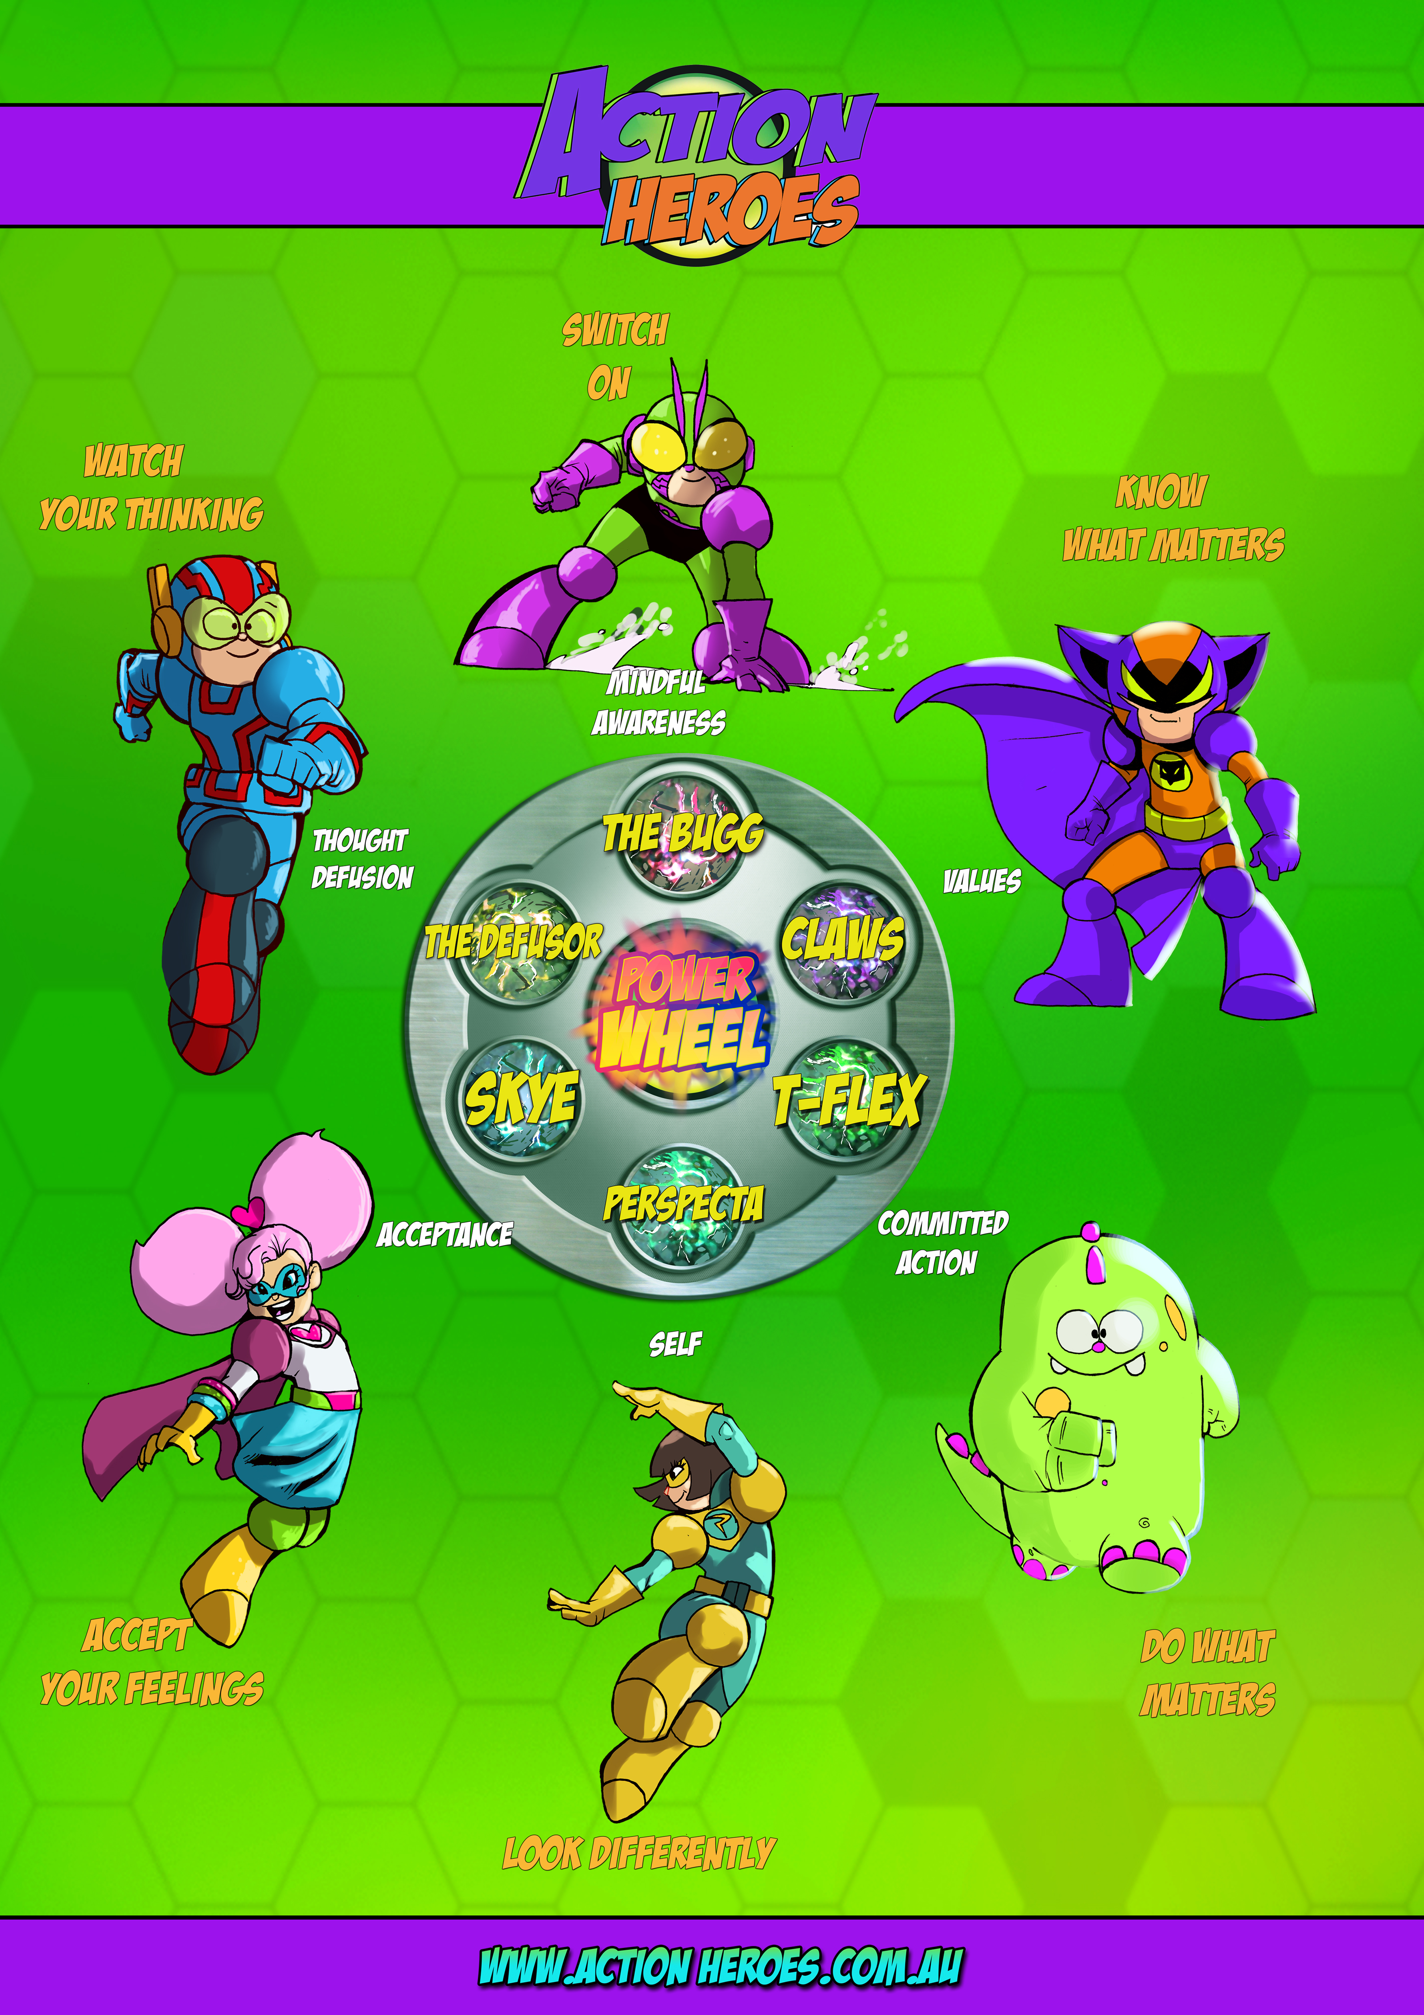

Slide 11
The Action Heroes Strategy Cards
Set of 72 cards
5 Instruction Cards
10 Strategy Cards per Hero + 6 Character Cards
Each card has visual language & verbal language
For professionals
For parents
For schools
www.actionheroes.com.au

Slide 12
Benefits of ACT
Can use in brief settings (not time constrained)
Clients connect with the approach
Flexibility is good for everyone
Shifts focus of attention re outcomes
More noticing of present-moment client actions = more creative metaphors
Increased openness & creativity
A language to use
It works

Slide 13
Mindlessness v. Mindfulness
We can be pulled into the past or the future
We can act mindlessly
Habits
Without values
Controlled by thoughts and feelings

Slide 14
Mindful Awareness: Switch On!
Being in the present moment
Flexibility & openness
Not buying into judgments
“Noticing” creates more openness

Slide 15
Switch On to…
5 senses
Body
Breath
Thoughts
Feelings
Values
Actions

Slide 16
My Mind and My Thinking
You are not your thoughts. Your thoughts come from your mind.
Entanglement with categorical, judgmental thoughts – predictive symbolic thoughts dominate over other sources of information.
You become fused with your thoughts and then go along with that version of reality. We need to learn how we can watch our thinking and then choose how we want to be in reality.
What happens when I am fused with my thoughts?

Slide 17
The Defusor: Watch Your Thinking

Slide 18
Defusion with Children
Kids will verbalise their thoughts as facts
Validate feelings first
Techniques that kids find useful:
Naming the story
Sing to a song, silly voice, animated/drawn
Leaves on stream
Therapist use of language – you & your mind
Defusion poems

Slide 19
Acceptance
“Good” & “bad” feelings
Philosophy towards feelings
Avoidance → Acceptance
We need to learn how to best manage our feelings in the short- and long-term
Acceptance means approaching our feelings
E.g. the blue brick; the pig storm

Slide 20
Perspecta: Look Differently
Person
Place/situation
Time
Self-map, drawing
Naming the “You”

Slide 21
Flexible Perspectives
Notice that you are noticing (observer self)
You are more than just…
The self map
The function of self-definitions
How can we bring one self into a different context?
Self-compassion

Slide 22
Values: Know what Matters
Values = repeated patterns of behaviour
Values identification (bulls eye)
The consistency of our behaviour
Over-investment in a value

Slide 23
Values
Moving towards vs. moving away
Thoughts/Feelings vs. Values
How do children relate to concept?
Once “free”, then values guide our decisions to act
Mind-reading machine, the speech, three wishes, spending lottery winnings

Slide 24
Values and Action
Do What Matters!
Understand your own behaviour
Values, goals & actions
Values in the present moment
Values as decision making guides

Slide 25
Committed Action
Behaviour analysis
Workability
Problem solving & skills required
Identifying & overcoming barriers
Action plans
Tracking consequences

Slide 26
Power Practice
Situation (context):
Power:
When:
How:
Who:
Track:
Workability:

Slide 27
The ACT-consistent Helper
The mindful helper
The defused helper
The accepted helper
The values-driven helper
Therapeutic relationship & therapy process
You must model the hexaflex as a therapist

Slide 28
Knowing when to use which process
Where are you in your hexaflex?
Be open to the present moment
What language is client using?
Defuse from right or wrong
Notice symbolism, metaphor potential
Use a metaphor
Check with client

Slide 29
Where to from here?
Individual & Groups – flexibility in delivery
Parent workshops
Whole systems approach – changing your language could make a difference
Strategy cards, stories to guide growth, board game, skills modules
In person & use of technology
Research partnerships

Slide 30
Thank you!
Phone: (07) 3366 7006
Email: sacha@actionheroes.com.au
sacha@happyminds.com.au
Websites: www.actionheroes.com.au
www.happyminds.com.au
Copyright. Slides not to be reproduced without permission
Notes:
Insert Copyright info.

